Slide 1

Date: 28/11/2025
Student Name : Giridhar Reddy Goddilla
Student ID: 23067661
Module: Data Science Project
University: University Of Hertfordshire
Supervisor: Dr. Vito Graffagnino
Module Leader: Dr. Darshan Kakkad

Slide 2

Table of Contents
Fake Job Posting Detection — End-to-End Machine Learning & Deep Learning Project
Introduction
Research Problem & Objectives
Dataset Description & Literature Background
Exploratory Data Analysis (EDA)
Feature Engineering
Machine Learning & Deep Learning Models
Hyperparameters & Model Architecture
Results & Evaluation Metrics
Interpretation of Results
Conclusion & Future Work
GitHub Repository
References
Q&A

Slide 3

Introduction
Online job portals have become primary platforms for recruitment.
Alongside genuine listings, fake job postings are increasing rapidly.
These scams imitate real job ads and target job seekers for:
- personal data theft,
- financial scams,
- identity misuse.
Fake postings often appear professional, making them difficult to recognise at first glance.
The scale of job postings makes manual detection impractical and ineffective.
This creates a strong need for an automated system that can accurately identify fake job postings using data-driven methods.

Slide 4

2.Research Problem & Objectives
Research Question & Objectives
How effectively can machine learning and deep learning models identify fake job postings using textual patterns, engineered features, and behavioral indicators?
Objectives
Analyse the dataset through detailed exploratory data analysis (EDA) to understand differences between real and fake job postings.
Engineer meaningful features such as scam keywords, text richness, punctuation patterns, missing-field indicators, and skill-based signals.
Build and train multiple Machine Learning models, including Logistic Regression, Random Forest, XGBoost, LightGBM, and CatBoost.
Implement NLP and Deep Learning approaches, such as TF-IDF + SVM and a BiLSTM model trained on job descriptions.
Evaluate model performance using accuracy, precision, recall, and F1-score, with special focus on detecting the minority fraudulent class.
Interpret model outputs to understand which features and patterns contribute most to detecting fake job postings.
quis proident Lorem incididunt nostrud nulla anim occaecat nisi in cillum exercitation nulla ullamco mollit irure ipsum laborum consectetur aute minim pariatur anim culpa ipsum ut qui et non consequat

Slide 5
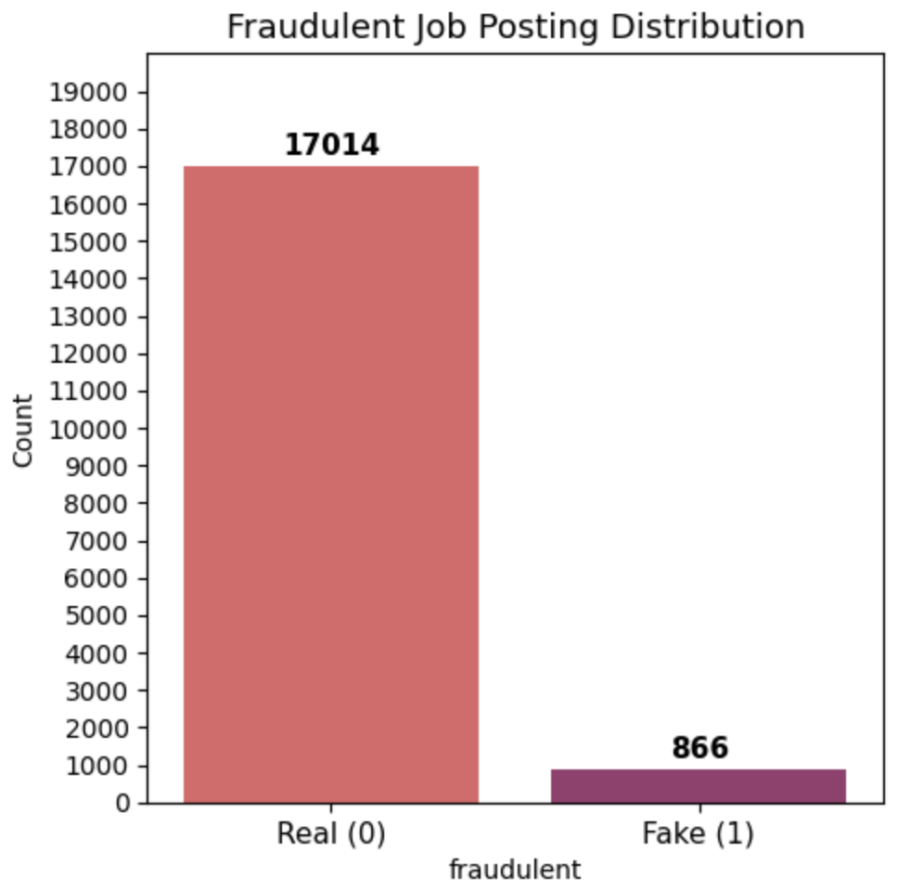
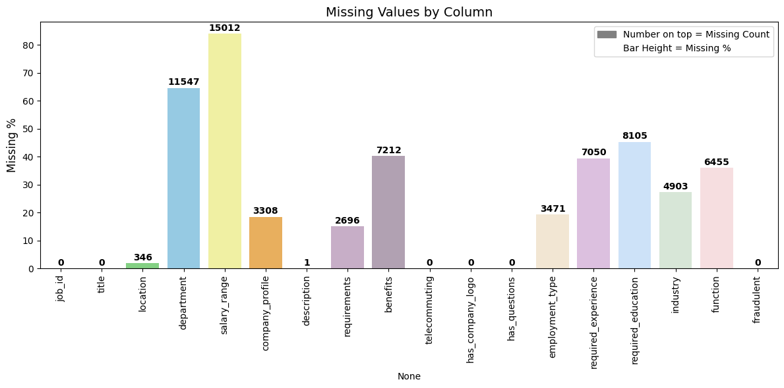
3. Dataset Description & Background Insights
Dataset Overview:
The project uses the Fake Job Posting Prediction Dataset from Kaggle.
Author: Shivam Bansal
It contains 17,880 job postings with 18 features, including:
job title, location, company profile
job description, requirements, benefits
metadata such as employment type, experience, education
The target variable fraudulent has two classes:
0 = Real job posting
1 = Fake job posting
Class Distribution
(Based on the first graph)
The dataset is highly imbalanced:
17,014 real posts
866 fake posts
This means fake postings represent only about 4.8% of the dataset.
This imbalance influences model training, requiring careful handling through class weights and appropriate evaluation metrics.
Missing Data Patterns
(Based on the second graph)
Several key fields contain very high missing values, especially:
salary_range (~84% missing)
department (~65% missing)
benefits, required_experience, required_education
Fake postings commonly leave out important details such as salary, benefits, and company information.
These missing patterns become strong indicators of fraud and are used as engineered features later.
Key Observations
Real job postings tend to be more complete and well-structured.
Fake postings often have:
missing key fields,
vague descriptions,
fewer company details.
These insights guide feature engineering and model selection.

Slide 6
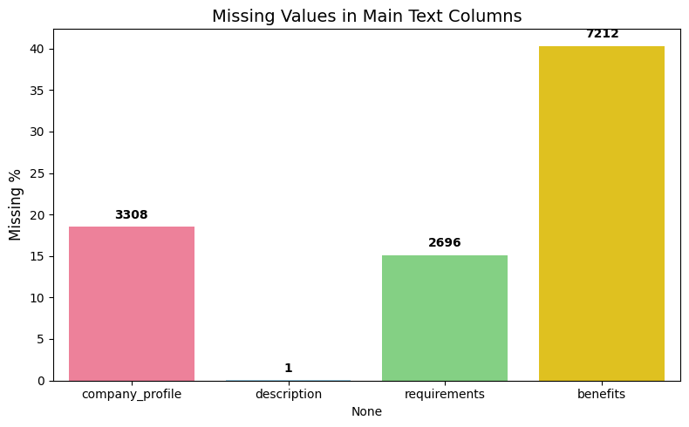
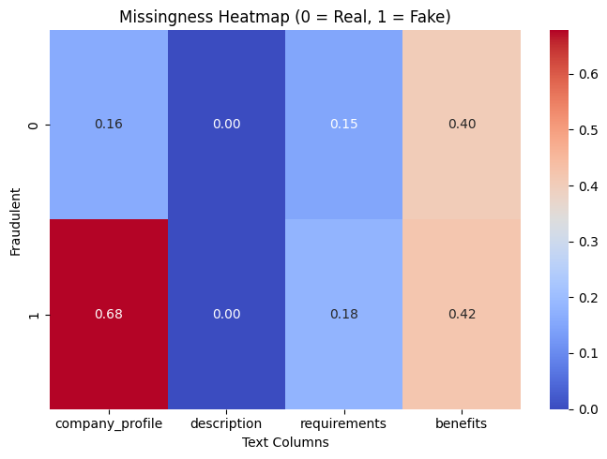
4.Exploratory Data Analysis (EDA)
1. Missing Values in Main Text Columns
(Graph: Missing Values in Main Text Columns)
The four major text columns — company_profile, description, requirements, and benefits — show significant differences in completeness.
description is almost fully available with only 1 missing value.
company_profile has around 18% missing,
requirements has about 15% missing,
benefits has the highest missingness at around 40%.
Together, these columns hold over 81% of all possible text data in the dataset, making them essential for understanding job-posting behaviour.
Insight: Fake job advertisements often lack important details such as benefits, company background, and job requirements, making missingness a valuable signal for fraud detection.
2. Missingness Patterns by Class (Real vs Fake)
(Graph: Missingness Heatmap — 0 = Real, 1 = Fake)
The heatmap clearly shows that fake postings have much higher missing values compared to real postings.
For company_profile, missingness jumps from 0.16 in real posts to 0.68 in fake posts — a strong indicator of fraudulent behaviour.
requirements and benefits also show noticeably higher missing rates in fake posts.
description remains consistently complete for both classes.
Key Interpretation: Scammers often avoid providing detailed information about the company, job benefits, or specific requirements. This pattern strongly supports feature engineering decisions such as:
missing_fields_count,
low_text_richness_flag,
text completeness features, which become powerful predictors in the classification models.
Conclusion from EDA
Missing values are not random; they strongly correlate with fraud.
Fake job postings are generally less detailed, less transparent, and more incomplete.
These findings directly guide model design and feature engineering for effective fraud detection.

Slide 7
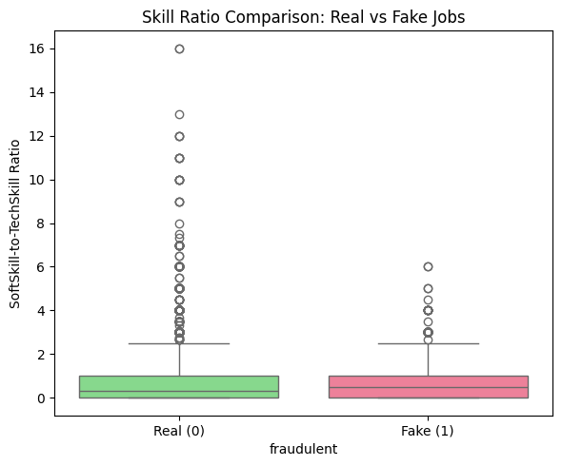
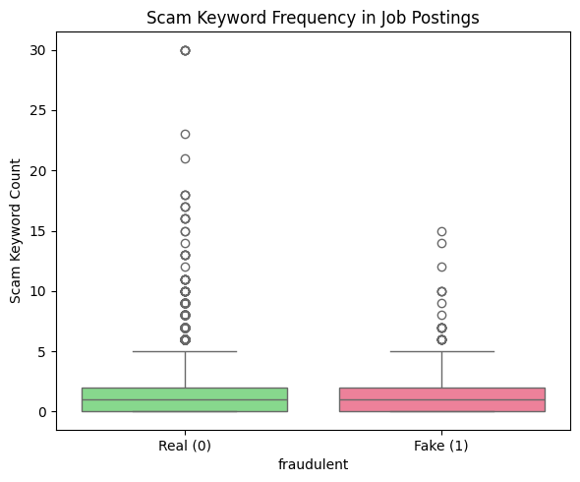
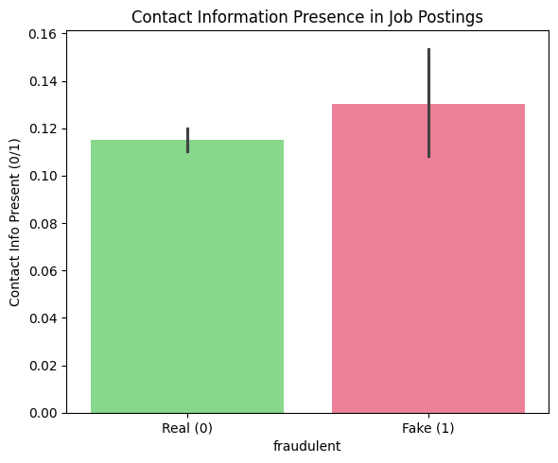
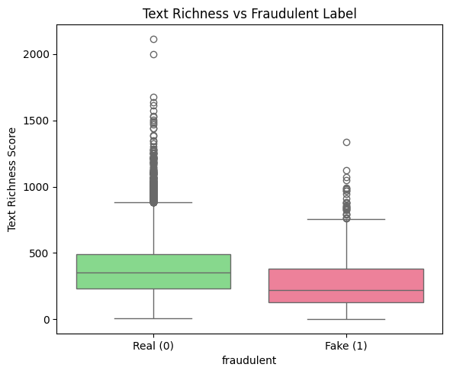
5. Feature Engineering
Feature engineering focused on capturing linguistic, structural, and behavioural patterns that distinguish real job postings from fake ones. Each feature group was inspired by patterns observed in EDA and is supported by the graphs below.
1. Scam Keyword Features
Goal: Detect aggressive, urgent, or suspicious language common in scam postings.
Created Feature:
scam_keyword_count number of scam-related words (e.g., earn, bonus, urgent, no experience, work from home).
Observation (Graph 1):
Fake postings show slightly higher scam keyword counts, reinforcing their use of persuasive or misleading language.
2. Skill-Based Features
Goal: Capture whether a posting uses specific technical requirements (real jobs) or generic soft skills (fake jobs).
Created Features:
softskill_count
techskill_count
softskill_to_techskill_ratio
Observation (Graph 2):
Fake postings often rely more on generic skills, while real postings emphasize technical skills and clearer requirements.
3.Contact information Presence
Goal: Identify unusual contact behavior fake ads often use personal emails or WhatsApp numbers.
Created Features:
email_present
phone_present
url_present
contact_info_present
Observation (Graph 3):
Fake postings have slightly higher contact-info presence, hinting at external redirection or identity harvesting.
4. Text Richness Features
Goal: Fraudulent ads tend to be short, vague, and lacking detail.
Created Features:
company_profile_wc
description_wc
requirements_wc
benefits_wc
text_richness_score
low_richness_flag
Observation (Graph 4):
Fake postings have significantly lower text richness, confirming their lack of depth.

Slide 8
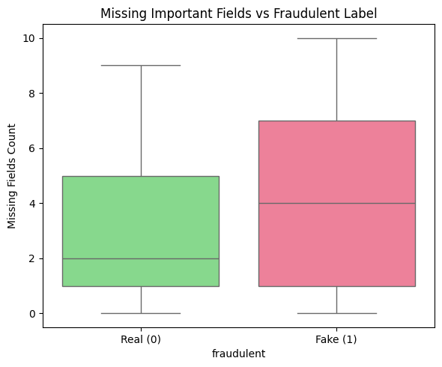
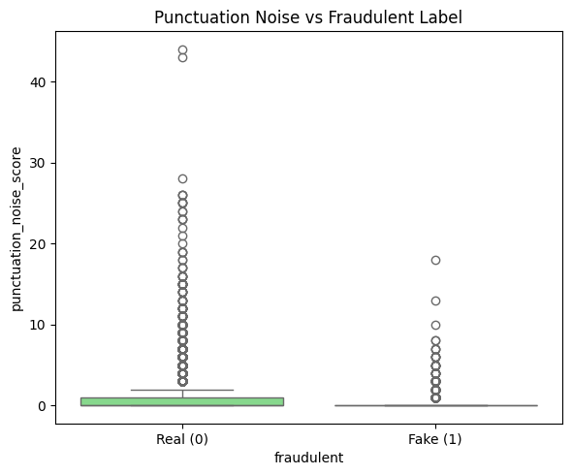
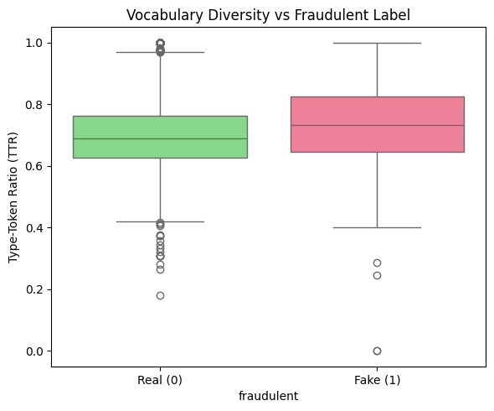
6. Grammar & Writing-Style Features
Goal: Scam ads often use emotional punctuation and inconsistent formatting.
Created Features:
punctuation_noise_score
uppercase_ratio
excess_exclamation_flag
Observations (Graphs 6 & 7):
Fake postings show higher punctuation noise.
Uppercase ratio is slightly higher in fake postings indicating emphasis or urgency tricks.
7. Vocabulary Complexity Features
Goal: Fake ads often use simpler language and fewer varied words.
Created Features:
desc_total_words
desc_unique_words
desc_ttr (Type-Token Ratio)
desc_avg_word_len
Observation (Graphs 8 & 9):
Fake postings show higher TTR but lower word count, indicating short but repetitive text.
Average word length shows subtle differences, useful for ML models.
5. Missing Information Features
Goal: Missing salary, benefits, company profile, or experience strongly indicates fraud.
Created Features:
missing_fields_count
high_missing_flag
Observation (Graph 5):
Fake postings have more than double the missing fields compared to real postings.

Slide 9
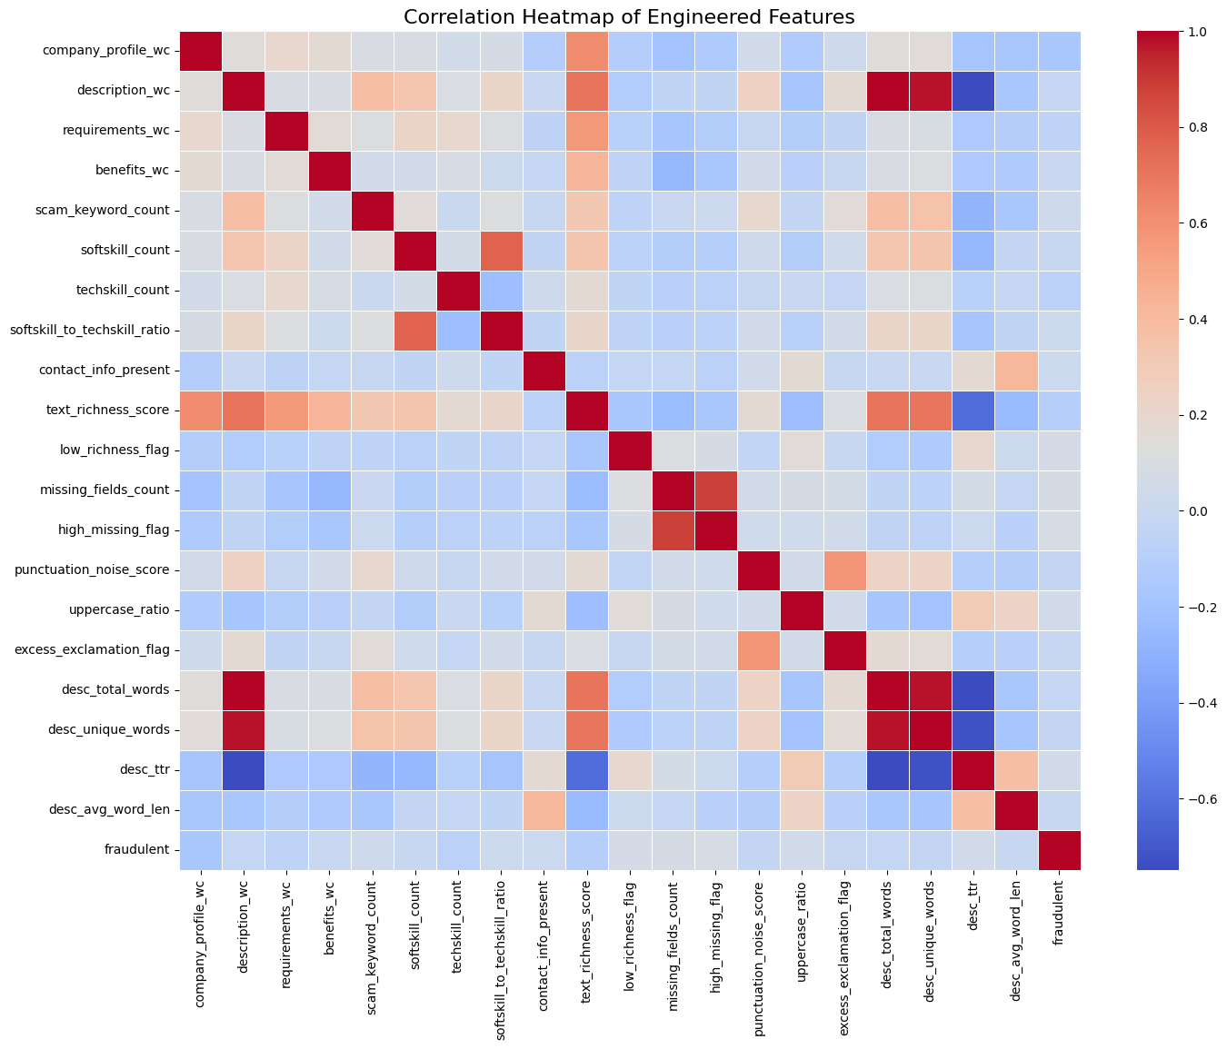
Correlation Heatmap (Crisp Explanation):
The correlation heatmap provides a clear overview of how the engineered features relate to each other and to the fraudulent label.
Text richness features (total words, unique words, richness score) strongly correlate with each other and show a negative correlation with fraud, meaning fake posts are shorter and less detailed.
Missing information features (missing_fields_count, high_missing_flag) show a clear positive correlation with fraud — fake postings leave out more key details.
Scam keyword count shows a moderate positive correlation, indicating scammers use persuasive keywords more often.
Writing-style features (punctuation noise, uppercase ratio) show mild correlations but still help identify unprofessional or emotional language in fake ads.
Contact info presence has a small positive correlation with fraud, reflecting unusual emails or phone numbers in fake postings.
Overall: The heatmap confirms that missing fields, low text richness, and scam language are the strongest indicators of fraudulent job postings.

Slide 10

6. Machine Learning & Deep Learning Models
This project used a combination of traditional machine learning and advanced deep learning approaches to classify job postings as real or fake.
Machine Learning Models
A range of supervised ML models were trained using the engineered features:
1. Logistic Regression
Baseline linear classifier
Helps understand feature influence and decision boundaries
2. Decision Tree
Captures simple non-linear patterns
Interpretable but prone to overfitting
3. Random Forest
Ensemble of decision trees
More stable and robust than a single tree
4. Gradient Boosting
Sequential tree boosting
Learns from mistakes of previous trees
5. XGBoost
Highly efficient gradient boosting
Tuned with scale_pos_weight to handle class imbalance
6. LightGBM
Faster, leaf-wise boosting algorithm
Excellent performance on structured data
7. CatBoost
Handles categorical features and overfitting well
Strong performance with minimal preprocessing
Deep Learning Models
Deep learning was applied to capture richer text patterns directly from the job descriptions.
1. TF-IDF + Linear SVM
TF-IDF converts text into numerical vectors
Linear SVM classifies based on word importance
Strong benchmark for NLP tasks
2. BiLSTM Model
Preprocessing: Tokenization (20,000 words), Padding (max length 200)
Architecture:
Embedding layer
Bidirectional LSTM (64 units)
Dense layers with dropout
Captures long-range dependencies and semantic meaning in text
Effective for detecting subtle scam language patterns
Why Use Both ML and DL?
Machine learning models excel with structured, engineered features such as missing fields, scam keywords, and text richness.
Deep learning models excel at learning semantic patterns directly from raw text.
Using both approaches gives a more comprehensive detection system.

Slide 11
7. Hyperparameters & Model Architecture
This project used a combination of machine learning and deep learning models, each configured with tuned hyperparameters to improve performance and handle class imbalance.
Machine Learning Model Hyperparameters
2. Deep Learning Model Architecture (BiLSTM)
The BiLSTM model was trained using only the job description text.
Text Preprocessing
Vocabulary size: 20,000 words
Sequence length: 200 tokens
Tokenization + padding for uniform inputs
BiLSTM Architecture
Embedding Layer
embedding_dim = 64
Converts words to dense vector representations
Bidirectional LSTM (64 units)
Learns forward + backward text dependencies
Captures semantic cues in scam-like sentences
Dropout Layers (0.5)
Prevent overfitting
Improves generalization
Dense Layer (32 units, ReLU)
Learns intermediate text patterns
Output Layer (Sigmoid)
Generates probability of fraud
Why These Hyperparameters Matter
The dataset is highly imbalanced, so boosting models used scale_pos_weight to avoid ignoring fraudulent samples.
LightGBM/XGBoost hyperparameters help capture complex interactions between engineered features.
The BiLSTM architecture learns meaningful semantic patterns that engineered features cannot capture.
TF-IDF + SVM provides a strong classical NLP baseline for comparison.
XGBoost
n_estimators = 300
max_depth = 8
learning_rate = 0.05
subsample = 0.8
colsample_bytree = 0.8
scale_pos_weight = (negative / positive) → handling severe class imbalance Strength: Learns complex non-linear fraud patterns effectively.
LightGBM
n_estimators = 400
learning_rate = 0.05
subsample = 0.8
colsample_bytree = 0.8
scale_pos_weight = imbalance ratio Strength: Fast and efficient; delivers excellent recall and stability.
CatBoost
iterations = 400
depth = 8
learning_rate = 0.05
loss_function = "Logloss"
scale_pos_weight = imbalance ratio Strength: Handles categorical behavior and reduces overfitting.
SVM + TF-IDF
TF-IDF: max_features = 5000, ngram_range = (1,2), min_df = 5
SVM: C = 1.0, class_weight = "balanced" Strength: Best recall among ML models for detecting fake postings.

Slide 12
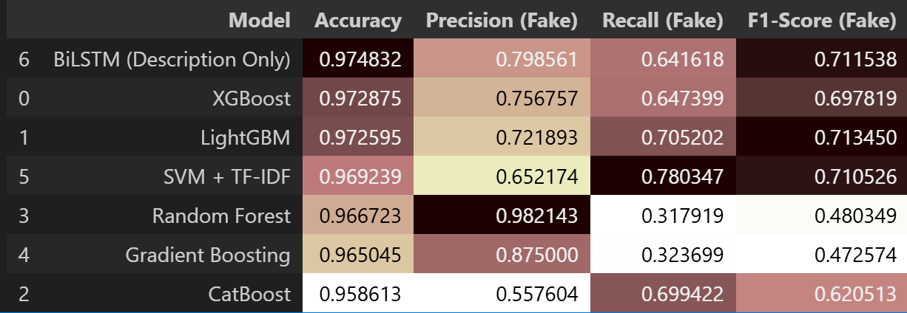
8. Results & Evaluation Metrics
The models were evaluated using Accuracy, Precision, Recall, and F1-score for the Fake (fraudulent) class. Since fake postings only make up ~4.8% of the dataset, metrics for the fake class are the most important.
Best Overall Performer — BiLSTM (Description Only)
Accuracy: 0.9748
Precision: 0.7986
Recall: 0.6416
F1-Score: 0.7115
Why it works best:
Learns semantic and contextual patterns directly from job descriptions.
Captures scam-like tone, phrasing, and writing style better than ML features alone.
1. XGBoost
Accuracy: 0.9729
Precision: 0.7568
Recall: 0.6474
F1-Score: 0.6978 Strength: Excellent at handling engineered features (missing fields, richness, scam keywords).
2. LightGBM
Accuracy: 0.9726
Precision: 0.7219
Recall: 0.7052
F1-Score: 0.7135 Strength: Best balance between precision and recall among ML models.
3. SVM + TF-IDF
Accuracy: 0.9692
Precision: 0.6522
Recall: 0.7803 (highest recall among ML models)
F1-Score: 0.7105 Strength: Excellent at catching fake postings due to strong text-based pattern recognition.
Moderate Performers
Random Forest
Very high precision (0.9821)
Very low recall (0.318) → misses most fake cases
Gradient Boosting
High precision (0.8750)
Low recall (0.324)
CatBoost
Balanced but overall weaker
F1-Score: 0.6205
Key Takeaways
BiLSTM gives the best overall performance due to its strong understanding of text semantics.
LightGBM and XGBoost are the strongest ML models, benefiting from engineered features.
SVM + TF-IDF is excellent for recall, making it effective for identifying rare fraudulent cases.
Models like Random Forest and Gradient Boosting show high precision but fail to detect most fake postings due to class imbalance.

Slide 13
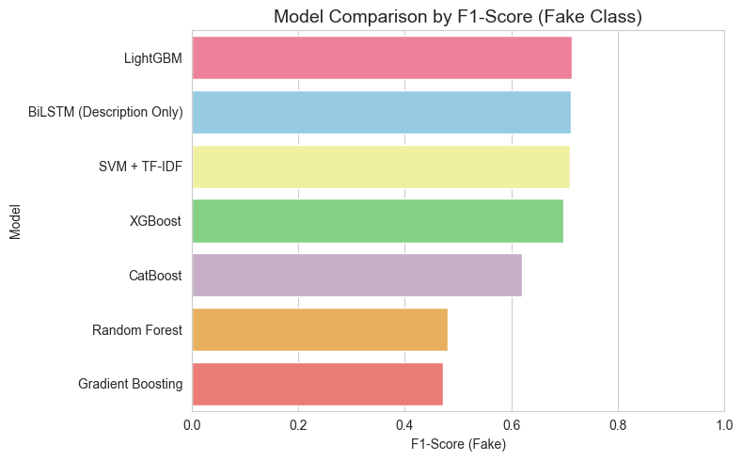
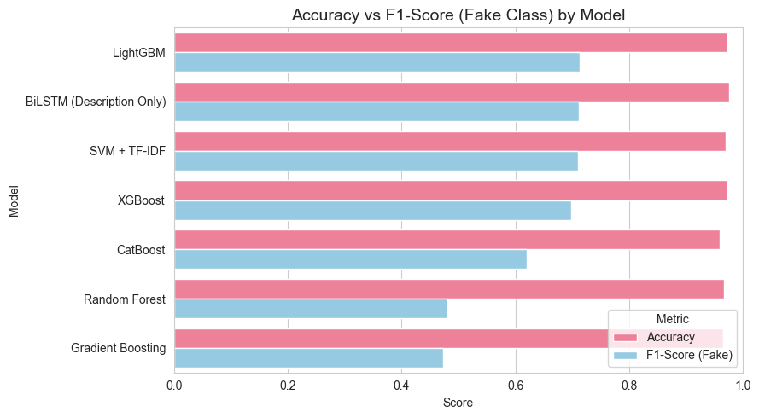
F1-Score Comparison (Fake Class)
LightGBM, BiLSTM, SVM + TF-IDF, and XGBoost clearly emerge as the strongest performers.
All four models achieve F1-scores around 0.70–0.72, meaning they balance precision and recall effectively for the fake class.
CatBoost performs moderately well.
Random Forest and Gradient Boosting show significantly lower F1-scores (~0.47–0.48), indicating difficulty detecting fraudulent postings despite high accuracy.
Insight: F1-scores show that the best models are the ones that balance both precision and recall not just accuracy.
2. Accuracy vs F1-Score Comparison
This graph highlights an important observation:
Many models (e.g., Random Forest, Gradient Boosting) achieve high accuracy simply because fake postings are rare.
But their F1-scores are low, meaning they barely detect fake postings.
Models like BiLSTM, LightGBM, XGBoost, and SVM + TF-IDF maintain both high accuracy and high F1-score, making them far more reliable.
Insight: Accuracy alone is misleading for imbalanced datasets; F1-score reveals the true fraud-detection ability.
These Comparisons Tell Us
BiLSTM and LightGBM consistently deliver strong overall performance.
SVM + TF-IDF excels at catching fake postings (high recall).
XGBoost provides a strong balance between precision and recall.
Random Forest and Gradient Boosting, despite high accuracy, are not suitable for fraud detection because they fail to identify fake postings.

Slide 14

9. Interpretation of Results
The results reveal clear patterns in how fraudulent job postings differ from genuine ones. Both machine learning and deep learning models highlight the same underlying behaviours.
1. Fake Postings Lack Detail
Models consistently focused on:
lower text richness,
fewer unique words,
shorter company profiles,
missing benefits, requirements, and salary fields.
Interpretation: Scammers avoid providing verifiable information.
2. Missing Information Is a Strong Fraud Indicator
Features like:
missing_fields_count
high_missing_flag
show strong correlation with fraud and significantly influenced model predictions.
Interpretation: Fraudulent ads intentionally leave out details that can be validated.
3. Linguistic and Behavioural Signals Matter
Features such as:
scam_keyword_count,
punctuation_noise_score,
uppercase_ratio,
softskill_to_techskill_ratio
help models detect the tone, urgency, and writing style scammers use.
Interpretation: Fake postings often use persuasive keywords, emotional punctuation, and vague soft skills instead of real requirements.
4. Deep Learning Captures Hidden Scam Patterns
The BiLSTM model performed best because it:
understands sentence flow,
identifies subtle scam phrasing,
detects unnatural writing patterns.
Interpretation: Deep learning captures semantic cues that engineered features cannot.
5. Recall vs Precision Differences
SVM + TF-IDF shows highest recall → best at catching fake postings.
Random Forest & Gradient Boosting show high precision but low recall → they rarely misclassify a real job as fake, but miss many fake ones.
Interpretation: Choosing the right model depends on whether the priority is catching more scams (recall) or avoiding false alarms (precision).
Overall Insight
Fraudulent job postings show a consistent pattern of:
missing structured information,
weak or vague descriptions,
higher scam-related word usage,
behavioural style differences,
and unusual contact patterns.
Both ML and DL models successfully learn these signals, confirming that fraud detection is highly feasible using a data-driven approach.
Briefly elaborate on what you want to discuss.

Slide 15

10. Conclusion & Future Work
Conclusion
This project successfully developed a machine learning and deep learning-based system to detect fake job postings using both structured features and textual patterns.
EDA revealed that fake postings contain less text, more missing information, scam-related words, and unusual writing styles.
Engineered features capturing text richness, missing fields, keywords, and grammar patterns significantly improved model performance.
Deep learning using BiLSTM achieved the best overall performance by capturing semantic fraud cues directly from job descriptions.
Among machine learning approaches, LightGBM, XGBoost, and SVM + TF-IDF showed strong, balanced performance, while Random Forest and Gradient Boosting struggled with recall due to class imbalance.
Overall Insight: Fraud detection in job postings is highly feasible with a combination of engineered features and advanced NLP techniques.
Future Work
Implement transformer-based models (e.g., BERT, RoBERTa) to improve contextual understanding and recall.
Collect larger, multi-platform datasets to improve generalisation across industries and job portals.
Hyperparameter optimisation using grid search or Bayesian optimisation for further model improvement.
Deploy a real-time fraud detection system as a web API or plugin for job portals.
Model interpretability tools (e.g., SHAP/LIME) to explain decisions and increase trust.
Handling evolving scam techniques by periodically retraining models with newer postings.

Slide 16
11. GitHub Repository
https://github.com/Giridharreddygoddilla/MSc-Data-Science-Project

Slide 17
12. References
Reddy, K.R., Indrani, G., Kumar, N.P. and Krishna, K.V. (2025) ‘Fake Job Posting Detection using Machine Learning Algorithms’. IEEE, pp. 822–827. https://ieeexplore-ieee-org.ezproxy.herts.ac.uk/document/11200792
Nayagam, S., Kariraman, R., Muralidaran, S. and Nabi, Y.A. (2025) ‘Fake job post prediction using machine learning’, AIP conference proceedings, 3279(1).https://pubs-aip-org.ezproxy.herts.ac.uk/aip/acp/article/3279/1/020036/3341677/Fake-job-post-prediction-using-machine-learning
Akram, N., Irfan, R., Al-Shamayleh, A.S., Kousar, A., Qaddos, A., Imran, M. and Akhunzada, A. (2024) ‘Online Recruitment Fraud (ORF) Detection Using Deep Learning Approache.https://ieeexplore-ieee-org.ezproxy.herts.ac.uk/document/10614582
P, P.K.B., J, B.D., G, G. and M, N., 2025. Fake Job Post Detection Using Machine Learning. In: 2025 International Conference on Computing for Sustainability and Intelligent Future (COMP-SIF). Bangalore, India, pp. 1–6. DOI: 10.1109/COMP-SIF65618.2025.10969867.https://ieeexplore-ieee-org.ezproxy.herts.ac.uk/document/10969867
Medapati, J., Arradi, Y., Kongala, R., Hariharan, S., Shanmugapriyan, J. and Natarajan, K., 2025. Detection of Fake Online Recruitment using Machine Learning Approach. In: 2025 Third International Conference on Augmented Intelligence and Sustainable Systems (ICAISS). Trichy, India, pp. 1199–1203. DOI: 10.1109/ICAISS61471.2025.11041922.https://ieeexplore-ieee-org.ezproxy.herts.ac.uk/document/11041922

Slide 18



Thank you
Giridhar Reddy Goddilla
giridharreddygoddilla2002@gmail.com

